Slide 1






Requirements Analysis and Design
Group 18
The Audience: Mr. Pham Thai Ky Trung
The Presentation: Nguyen Van Hung – 520H0637
Le Huynh My Duyen – 520H0626

Slide 2
TABLE OF CONTENTS
1
2
3
4
5
Use case
Domain Diagram
State Diagram
Activity Diagram
UI

Slide 3
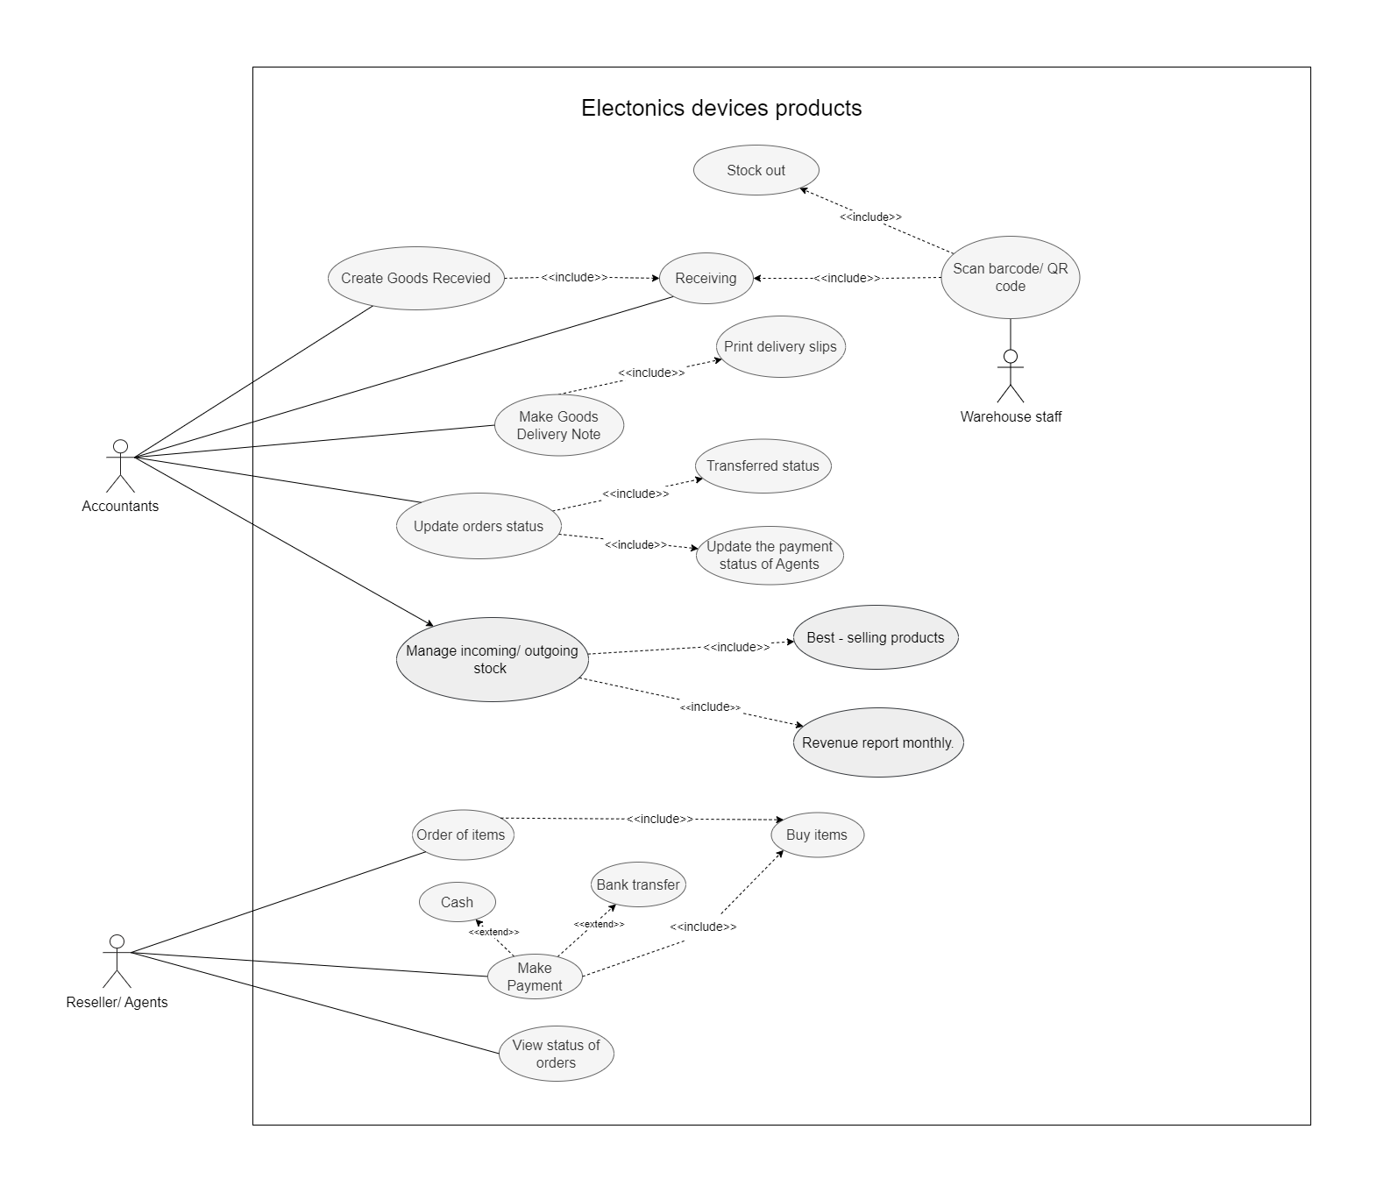
USE CASE
Electonics devices products

Slide 4

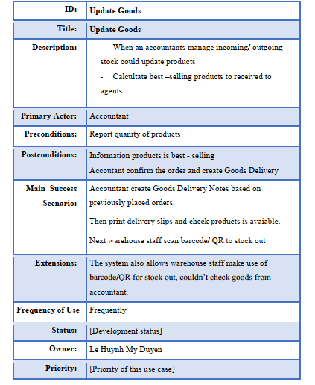


Use case description for Update Goods

Slide 5
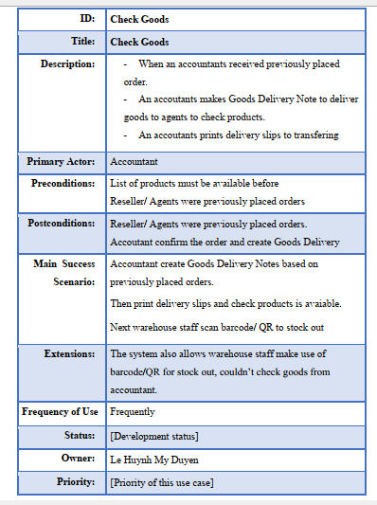
Use case description for Check Goods

Slide 6
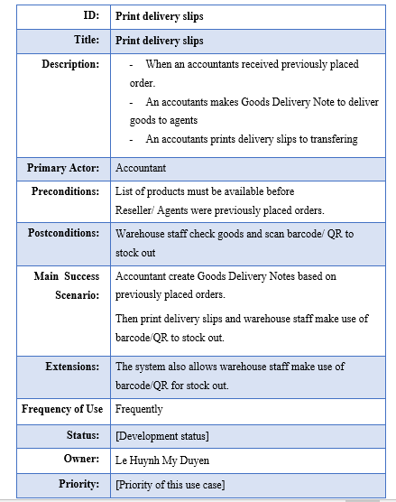
Use case description for Print delivery slips

Slide 7
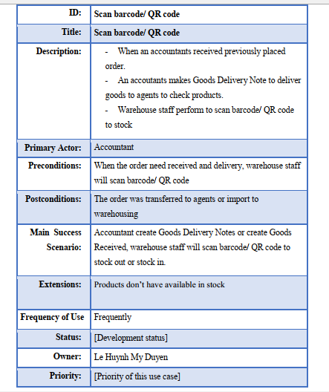
Use case description for Scan barcode/ QR code/ RFIDS

Slide 8
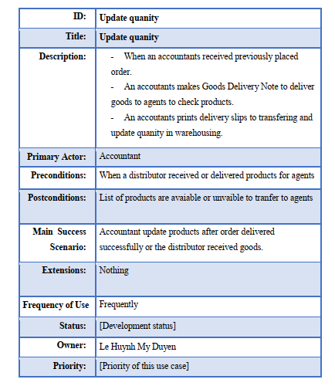
Use case description for Update quanity

Slide 9
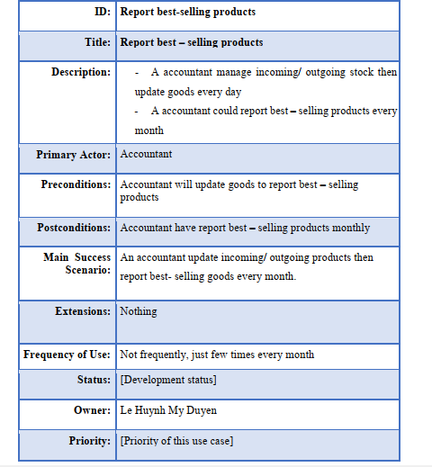
Use case description for Report best – selling products

Slide 10
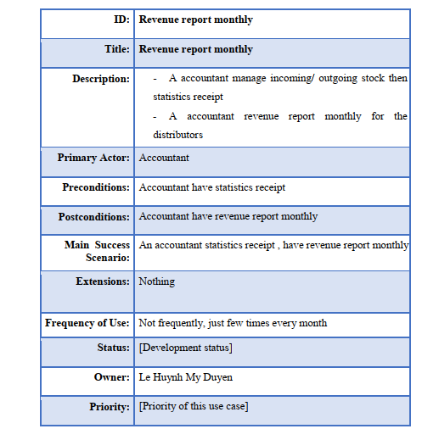
Use case description for Revenue report monthly

Slide 11
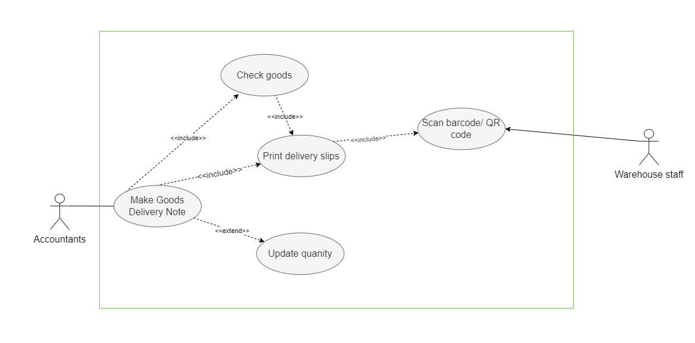
Make Goods Delivery Note

Slide 12
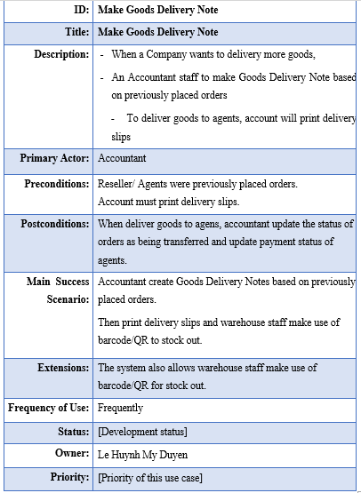
Use case description for Make Goods Delivery Note

Slide 13
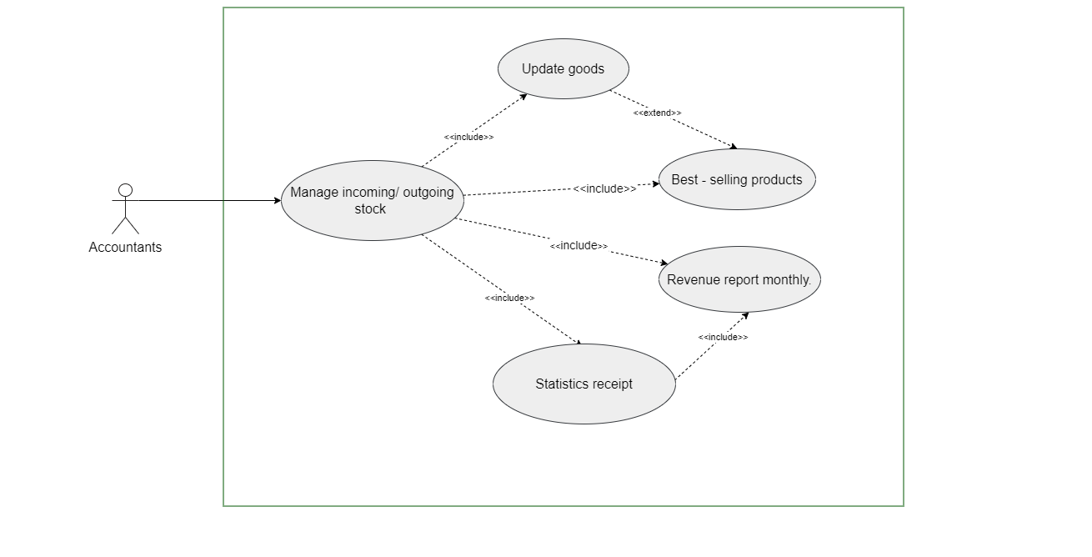
Manage warehouse activity

Slide 14
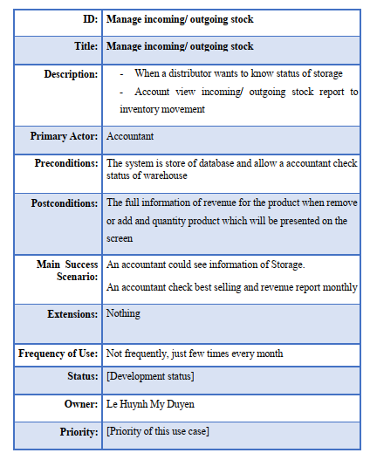
Use case description for Manage incoming/ outgoing stock

Slide 15
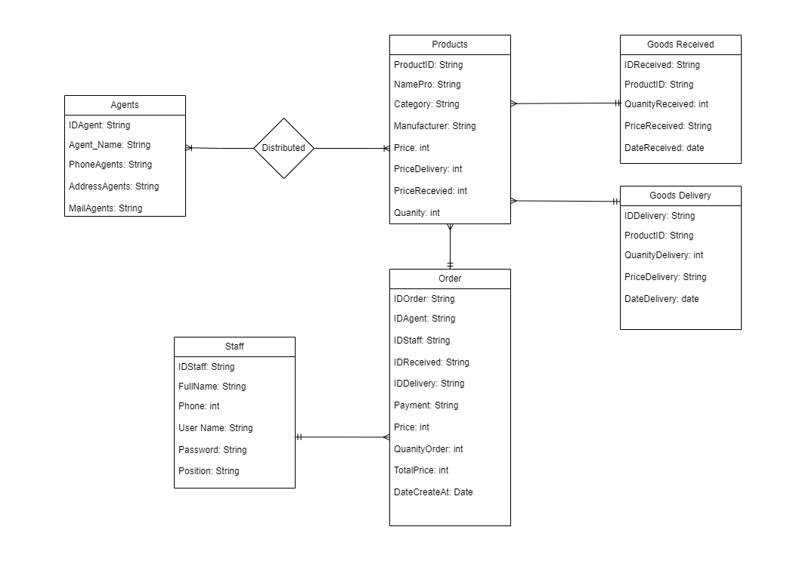
Domain Model Class Diagram

Slide 16
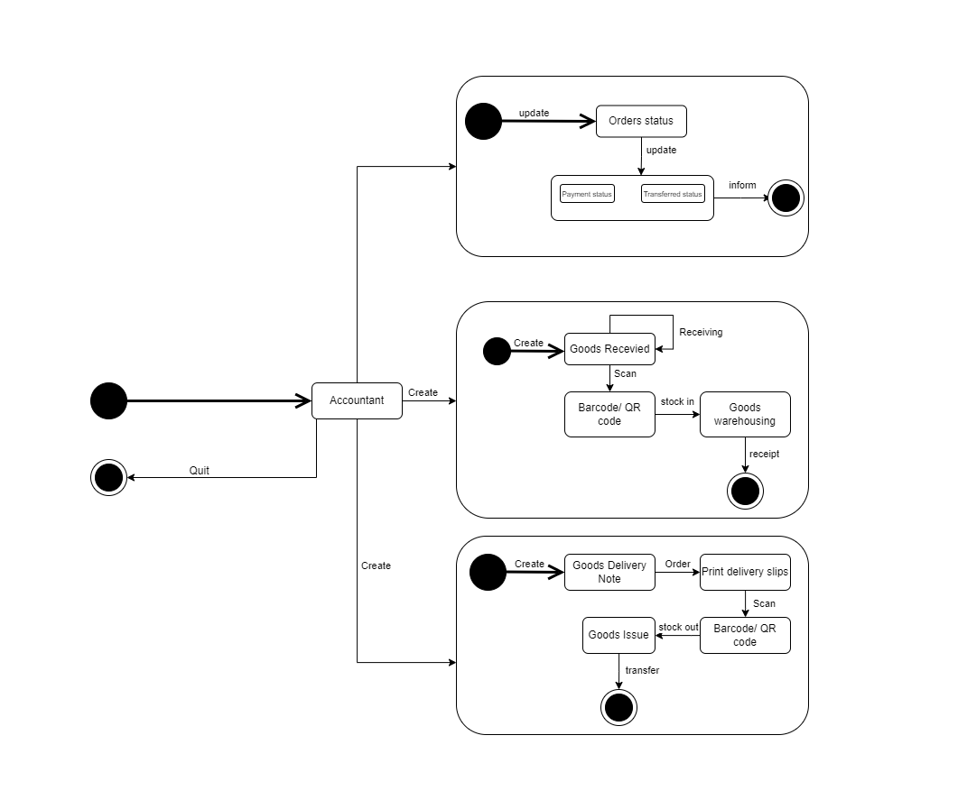
State Machine Diagram

Slide 17
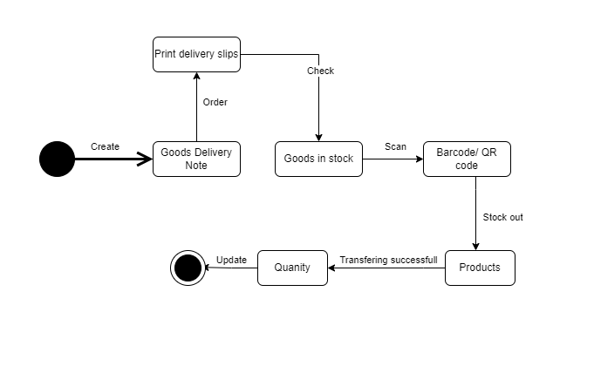
State Machine Diagram for Create Goods Delivery Note

Slide 18
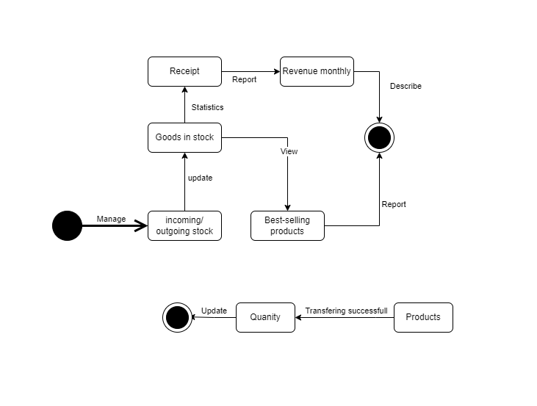
State Machine Diagram for Manage incoming/ outgoing stock

Slide 19

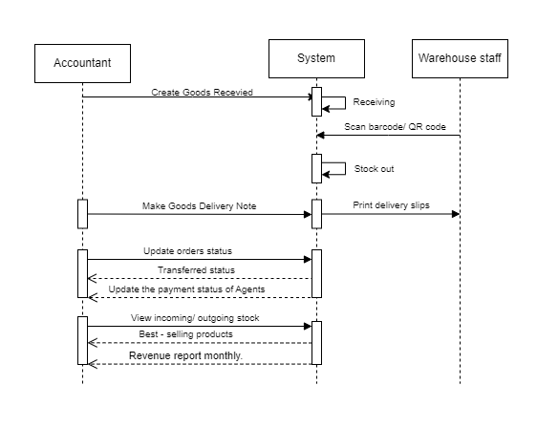
Sequence Diagram

Slide 20
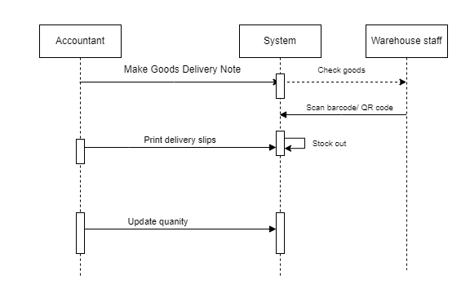
Sequence Diagram for
Make Goods Delivery Note

Slide 21
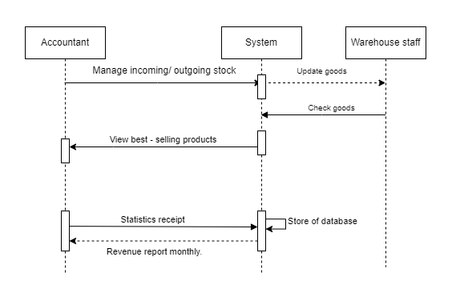
Sequence Diagram for
Manage incoming/ outgoing stock

Slide 22

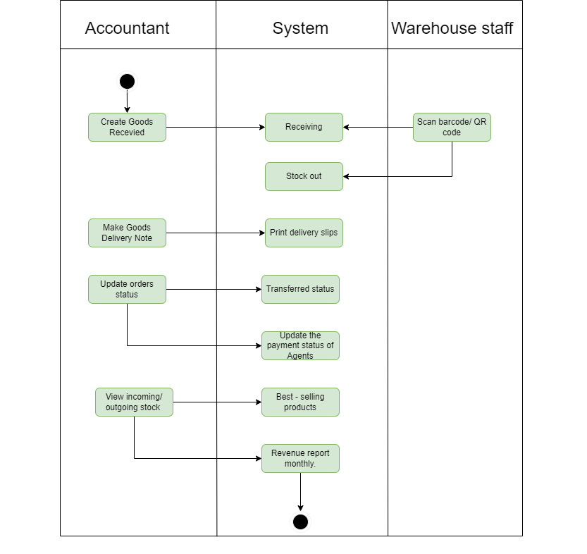
Activity Diagram

Slide 23
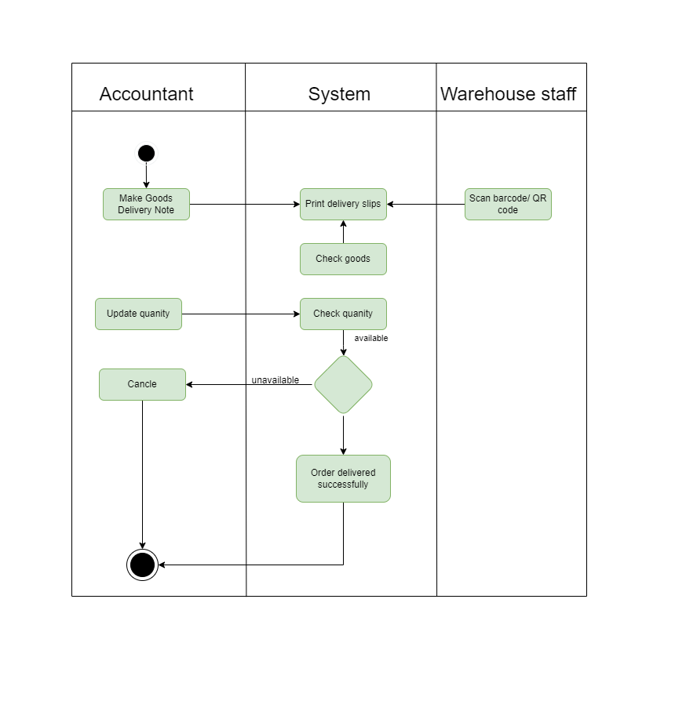
Activity Diagram Use Case: Make Goods Delivery Note

Slide 24
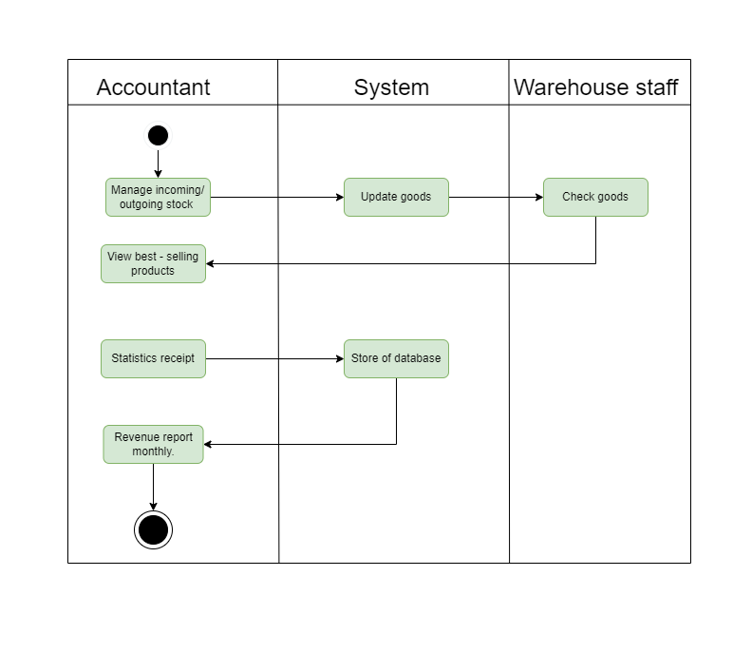
Activity Diagram Use Case: Manage incoming/ outgoing stock

Slide 25
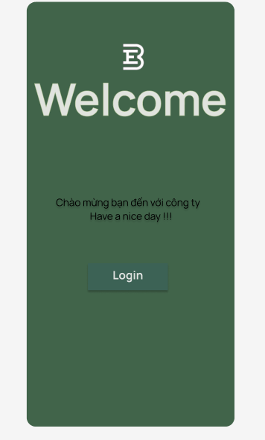
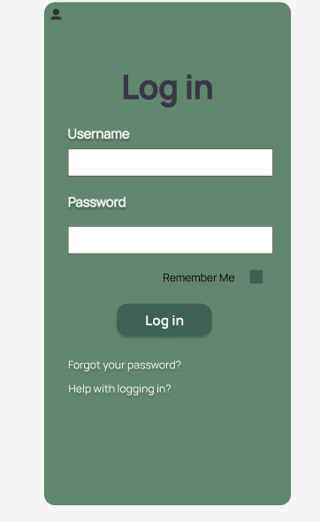
Accoutant Mobile Application

Slide 26
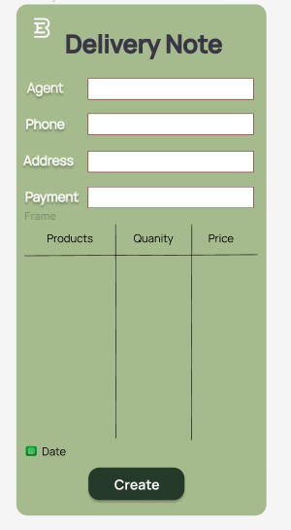
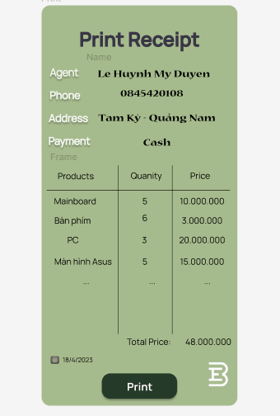
Create Delivery Note and Print Delivery Slips of Accoutant

Slide 27
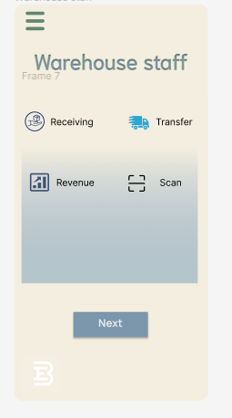

Main screen of Warehouse Manager

Slide 28
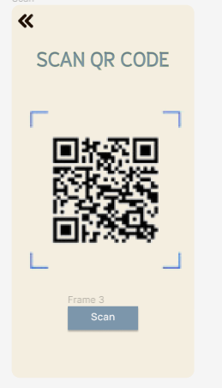
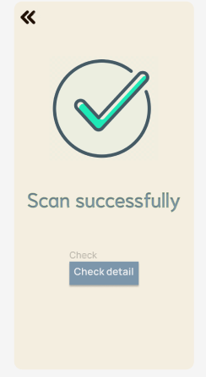
Scan barcode/ QR code of Warehouse staff

Slide 29




IDIN DIN
THANK YOU
FOR YOUR TIME!

